Slide 1
Team Contract Purpose of the Contract -This team contract outlines the expectations, communication methods, and ground rules for all team members. It ensures clarity, accountability, and collaboration to facilitate a productive and successful project. Each team member agrees to abide by the outlined responsibilities and contribute effectively to the project.
Team Members
The following individuals are members of the team:
Abhaya Bayalkoti - Project Manager
Bandana Magar - Front-End Developer
Prabin Pokhrel - Back-End Developer
Bikash Gurung - Tester

Slide 2
Roles And Responsibility:
Project Manager - Abhaya Bayalkoti
Oversee project progress and ensure timely completion.
Manage deadlines and task distribution efficiently.
Facilitate team communication and conflict resolution.
Maintain project documentation and ensure clarity.
Communication Method
Use Slack for daily updates and team discussions.
Schedule weekly Google Meet check-ins.
Provide email updates for critical project milestones
Ground rules:
Be punctual in meetings and discussions.
Foster a transparent and respectful team environment.
Ensure all tasks are properly assigned and tracked
.

Slide 3
Front-End Developer - Bandana Magar
Design and implement user-friendly interfaces.
Ensure responsiveness and cross-browser compatibility.
Collaborate with the back-end team for seamless integration
Communication Methods
Use Slack for daily design discussions.
Attend weekly review meetings to discuss design progress.
Provide updates on UI/UX improvements in Trello
Ground Rules
Follow modern UI/UX best practices.
Maintain version control with GitHub branches.
Keep design documentation up to date.

Slide 4
Back-End Developer - Prabin Pokhrel
Develop and maintain server-side logic and databases.
Optimize application performance and security.
Provide APIs and backend support for the front-end team.
Communication Methods
Use Slack to discuss API endpoints and logic changes.
Attend weekly backend check-in meetings.
Document API changes on GitHub and update Trello tasks.
Ground Rules
Write clean, secure, and well-documented code.
• Ensure timely integration with front-end functionalities.
• Follow proper database management protocols.

Slide 5
Tester - Bikash Gurung
• Conduct thorough software testing to identify and report bugs.
• Create and execute structured test cases.
• Work closely with developers to resolve issues efficiently.
Communication Methods
Use Trello to log and track testing progress.
Report findings in Slack and participate in weekly meetings.
Document and communicate critical bugs via GitHub Issues
Ground Rules
Ensure all reported bugs have clear replication steps.
• Maintain timely reporting and thorough documentation.
• Collaborate effectively with developers for troubleshooting

Slide 6
Meeting:
Regular meeting will be held weekly on Wednesday at 7:oo PM
Additional meetings may be scheduled as needed
Decision-Making Process
All major project decisions will be discussed in weekly meetings.
Urgent decisions will be communicated via Slack and agreed upon by a majority vote.
In case of conflicts, the Project Manager will mediate and make the final decision.

Slide 7
Work Timeline and Deadlines
WEEK | Task Description | Assigned Members | Deliverables
Week 1 | Project planning and requirement gathering | All members | Finalized project requirements document
Week 2 | Initial research and tool setup | All members | Selected tools and technologies list
Week 3 | UI/UX design and database schema creation | Bandana and Prabin | Design mock ups and initial database schema
Week 4 | Back-end API begins | Prabin | Initial API end points
Week 5 | Front-end development starts | Bandana | Basic front-end interface
Week 6 | Integration of front-end with back-end | Bandana and Prabin | Fully integrated basic prototype
Week 7 | Intermediate testing phase | Bikash | Bug report and feedback on protype
Week 8 | Back-end optimization and security implementation | Prabin | Optimized back-end with improved performance
Week 9 | Front-end enhancements and responsiveness testing | Bandana | Updated front-end interface
Week 10 | Comprehensive testing and debugging | Bikash | Detailed test reports and resolved bugs
Week 11 | Final project review and polish | All member | Finalized version of the project
Week 12 | Submission and presentation preparation | All member | Complete project submission with documentation and presentation slides

Slide 8
Quality Standards • Code should follow best practices and be reviewed before merging. • UI/UX should adhere to modern design principles and accessibility guidelines. • Testing should ensure functionality, performance, and security compliance. • Documentation must be maintained and kept up to date.
Conflict Resolution
• Issues should be addressed through open discussion in team meetings.
• If unresolved, the matter will be escalated to the instructor for guidance.
• Respect and professionalism must be maintained at all times.
Accountability
Each team member is responsible for their assigned tasks.
Lack of participation or missing deadlines without valid reasons will be discussed with the Project Manager.
Continuous non-cooperation may be reported to the instructor.
Code of Conduct
Respect all team members and their contributions.
Communicate effectively and provide constructive feedback.
Adhere to deadlines and contribute equally to the project.
Keep project-related discussions professional and focused.
Maintain confidentiality and integrity in handling project information.

Slide 9
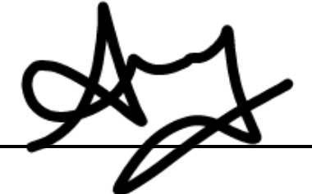
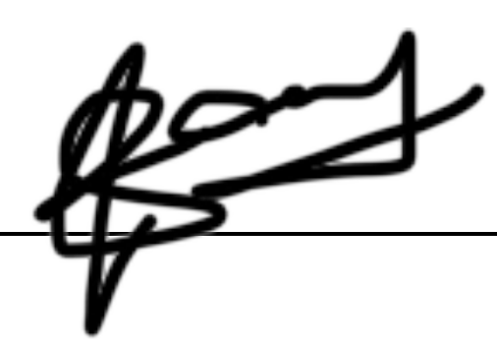
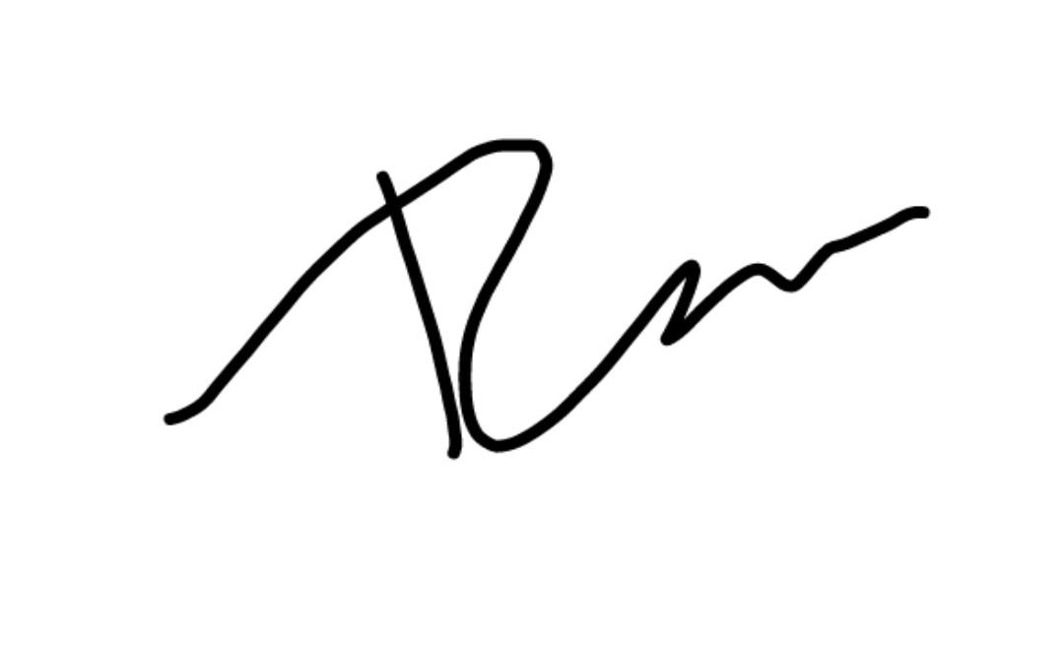
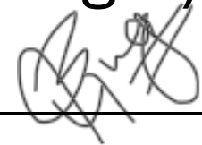
Termination Termination by Agreement: • The Contract may be terminated by mutual agreement of all members.
Termination for Cause:
• A member may be removed from the Team for failing to adhere to the terms of this Contract, subject to a majority vote by the remaining members.
By signing below, each member acknowledges that they have read, understood, and agree to abide by the terms of this Team Contract.
Signatures and Agreement:
Name | Role | Signature
Abhaya Bayalkoti | Project Manager
Bandana Thapa Magar | Front-End Developer
Prabin Pokhrel | Back-End Developer
Bikash Gurung | Tester

